Slide 1
Literature Review
on [1] “Transformer based Automatic COVID-19 Fake News Detection System” (Sunil Gundapu and Radhika Mamidi)

Slide 2
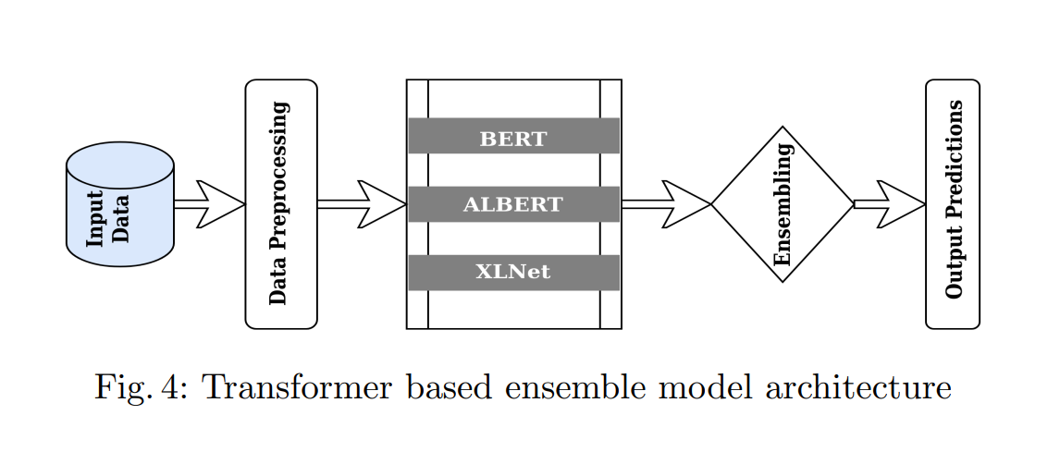
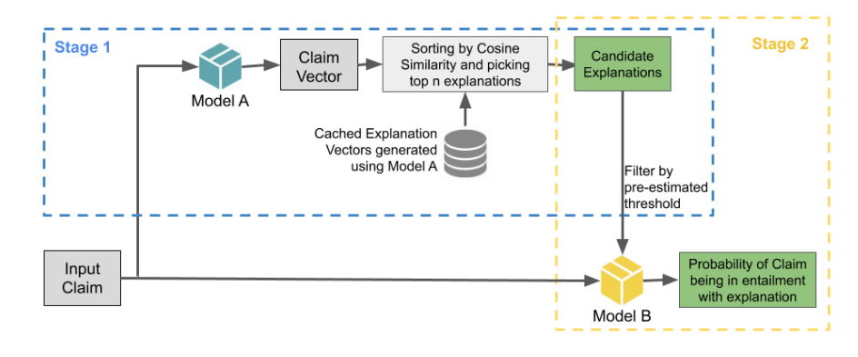
Methodology

Slide 3
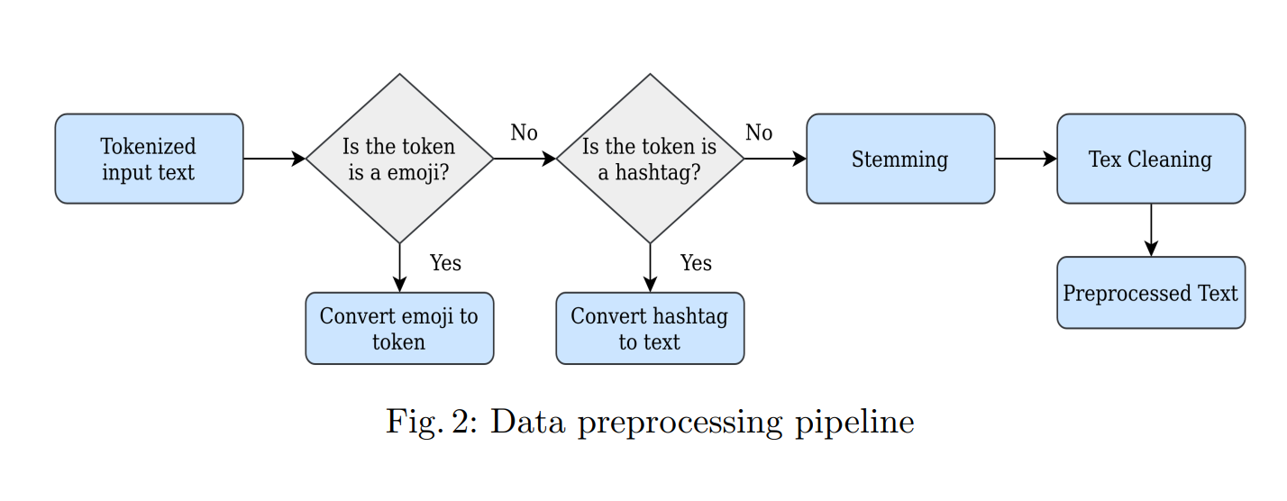
Data Preprocessing

Slide 4
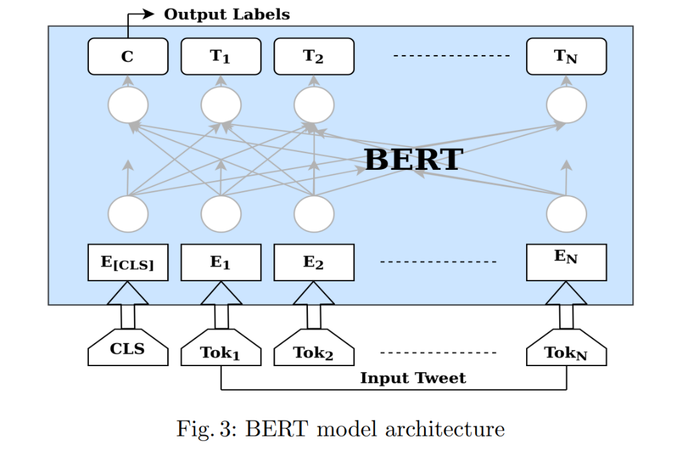
Bert Model
Pre-training
The model is trained on unseen data over various pretraining problems using a dataset in a particular language or in increases data with multiple languages.
Fine-tuning
All the initialized parameters are fine-tuned using the labeled data from certain tasks.

Slide 5
Bert Model
Added one additional output layer on top of the BERT model to calculate the conditional probability over the output classes, either fake or real.

Slide 6
XLNet Model
XLNet is an enhanced version of BERT. To understand the language context deeper, XLNet [29] uses Transformer-XL [30] as a feature engineering model, which alone is an adoption upon the native Transformer.
This Transformer XL model integrates the two components Recurrence Mechanism and Relative Positional Encoding (RPE) to the Transformer used in BERT to handle the long-term dependencies for texts that are longer than the maximum allowed input length.
Recurrence Mechanism will give context between two sequences at specific segments and RPE, which carries similarity information between two tokens.

Slide 7
ALBERT Model
Modern language models increasing the model size and quantity of parameters when pre-training natural language representations. They often give better improvements in many downstream tasks, but in some cases, they become harder due to memory limitation and longer hours of training. To address these problems, a self-supervised learning model ALBERT (A Lite BERT) [31] often uses parameter reduction techniques to increase model speed and lower memory consumption. We used the A Lite BERT model for our misinformation detection problem, which achieves better performance than DL models.

Slide 8
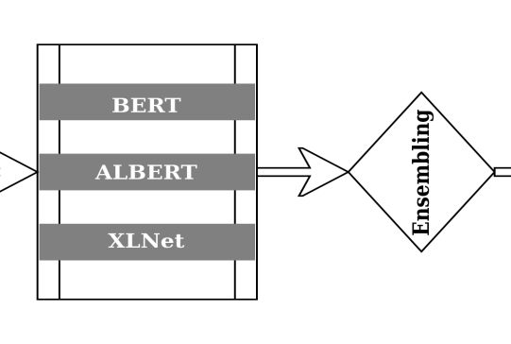
Ensemble Model
computes an average of all softmax values from these three transformer models after extracting the softmax probabilities from each model.

Slide 9
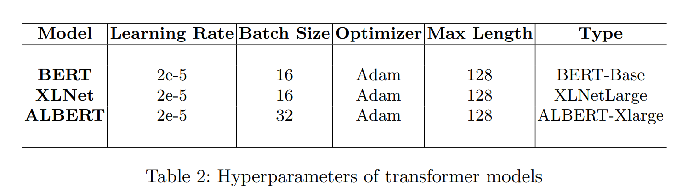
Hyperparameters

Slide 10
Supervised Machine Learning Models
traditional NLP approaches like
Linear Regression (LR),
Support Vector MAchines (SVM)
Passive Agressive Classifier (PAC)
XGBoost
Multi-Layer Perceptron (MLP)

Slide 11
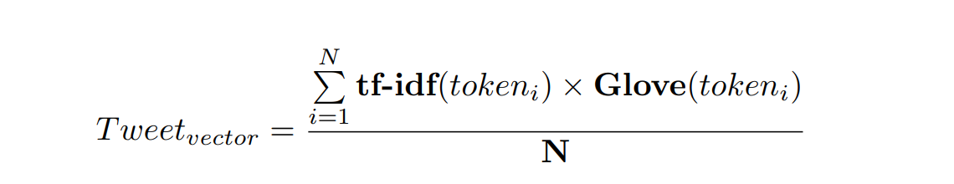
Supervised Machine Learning Models
study the results of above mentioned supervised models with the combination of three types of word vectors:
Word-level, n-gram level, and character level TF-IDF vectors with the feature matrix size of 100000.
2. English Glove [23] word embeddings with the dimension of 300.
3. TF-IDF weighted averaging with Glove embeddings. We described below the fake news vector construction.

Slide 12
Deep Learning Models
LSTM
We used Long Short-Term Memory (LSTM) architecture with two different pre-trained word embeddings Glove and Fasttext [25]. LSTM is a type of Recurrent Neural Network (RNN) that can solve long term dependency problem, and it is a well-suited model for sequence classification.
We converted the input data points into word vectors by using pre-trained word embeddings. These word vectors are passed as input to the LSTM layer. We stacked up two LSTM layers one after another with the dropout of 0.25. The size of LSTM is 128, and the last time step output is treated as input data point representation. The final time step’s outcome is passed as an input to a dense layer for fake news detection.

Slide 13
Deep Learning Models
2.BiLSTM with Attention
Sometimes not all the tokens in the input text contribute equally to the representation of input text. So we advantage word attention mechanism to catch the tokens’ prominent influence on the input data point. We built this attention mechanism on top of BiLSTM layers. The sequence of word vector is passed through a BiLSTM layer, which contains one forward and backward LSTM layer. Attention mechanism applied to the output of BiLSTM layer, which produces a dense vector. This dense vector is forwarded to a fully connected network.

Slide 14
Deep Learning Models
3. CNN
We explored a Convolution Neural Network (CNN) [27] model for misinformation detection. The model consists of an embedding layer, a convolution layer with 3 convolutions, a max-pooling layer, and a fully connected network.
In the embedding layer, the input texts are converted into n×d sequence matrix, Fake News Detection 7 where n is the length of the input data point and d is the length of the word embedding dimension.
In the convolution layer, fed the sequence matrix through three 1D convolutions of kernel sizes 3, 4, and 5. And each convolutions filter size is 128.
The convolution layer’s output is max pooled over time and concatenated to get the input datapoint representations in the max-pooling layer.
The output of the max-pooling layer is passed to a fully connected network with a softmax output layer.

Slide 15
Deep Learning Models
4. CNN + BiLSTM
A CNN and BiLSTM architecture is an ensemble of CNN and bidirectional LSTM models with Fasttext/Glove word embeddings.
In this architecture, the CNN extracts the maximum amount of features/information from the input text using convolution layers.
The output of CNN becomes the input to BiLSTM, which keeps the data in chronological order in both directions.

Slide 16
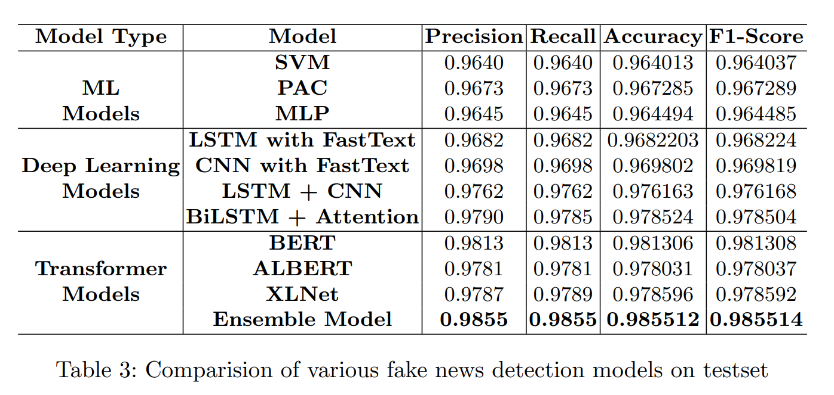
Experiment result

Slide 17
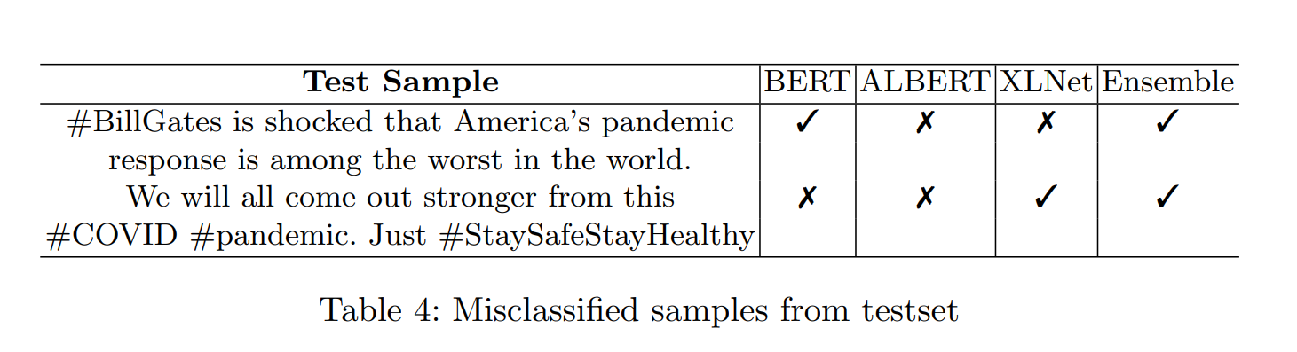
Experiment result

Slide 18
Conclusion
Presented various algorithms to combat the global infodemic, but transformer-based algorithms performed better than others

